Slide 1
Revolution Robotics Foundation
Firmware upload with JFlash Lite

Slide 2
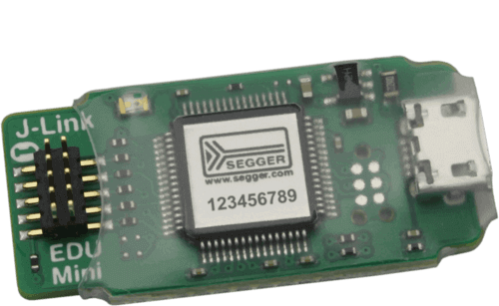
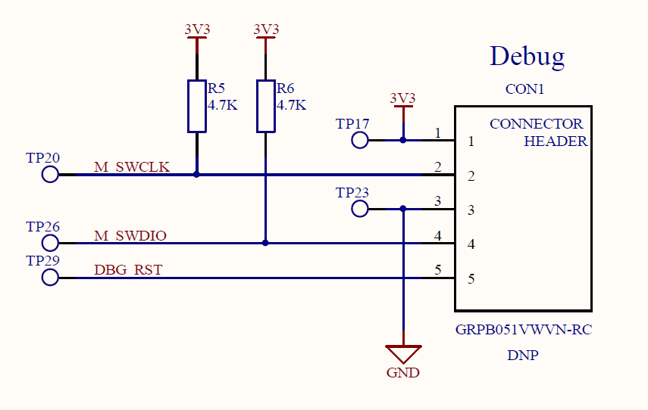
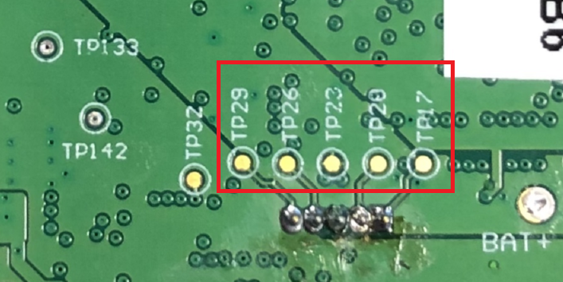
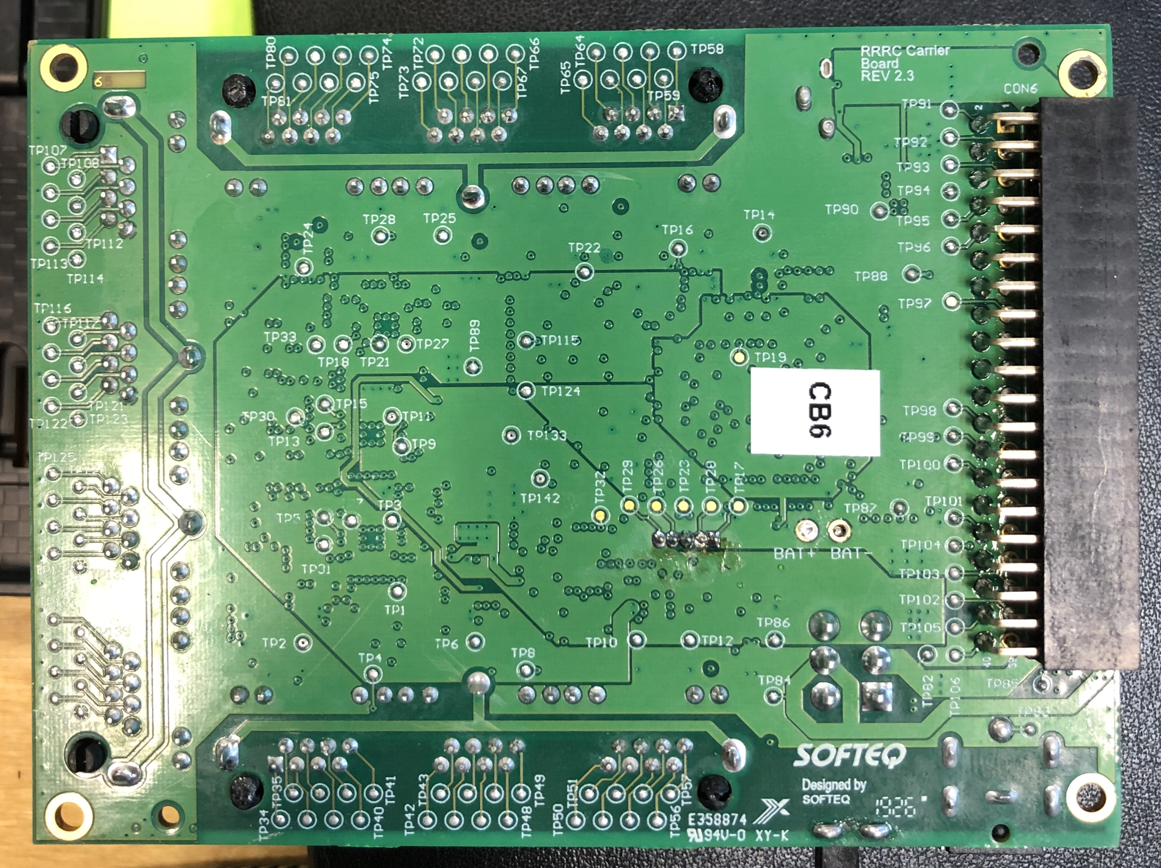
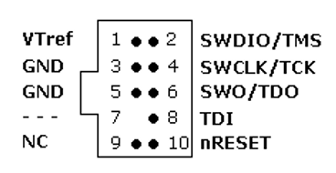
Connecting the JLink Mini debugger
You have to connect debugger pins:
Pin 1 to TP17
Pin 2 to TP26
Pin 3 to TP23
Pin 4 to TP20
Pin 10 to TP29
Please note, that you can flash the MCU firmware only when MCU is powered on!

Slide 3
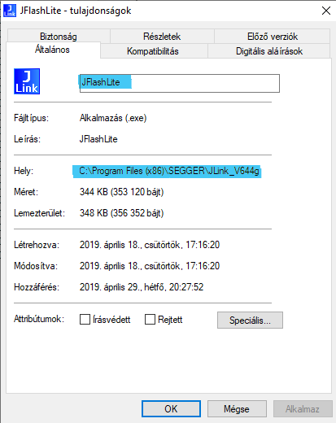
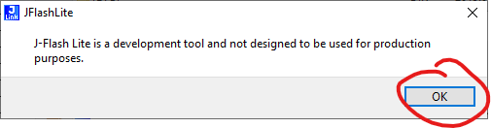
Using JLink JFlash Lite
1) Install JLink_Windows_V644g.exe
2) Open JFlashLite.exe from C:\Program Files (x86)\SEGGER\JLink_V644g
3) Accept popup

Slide 4
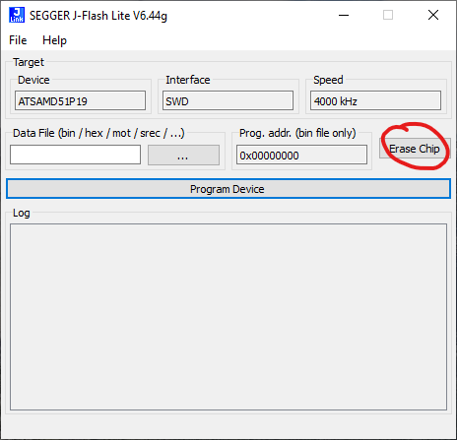
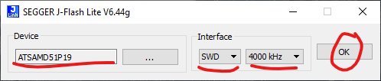
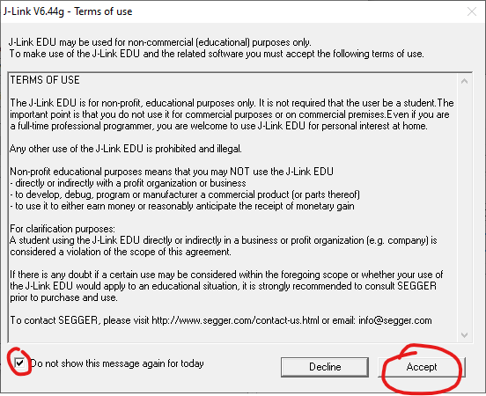
Flash MCU firmware with JFlash Lite I.
1) Select MCU type
2) Erase chip
3) Accept terms and conditions

Slide 5
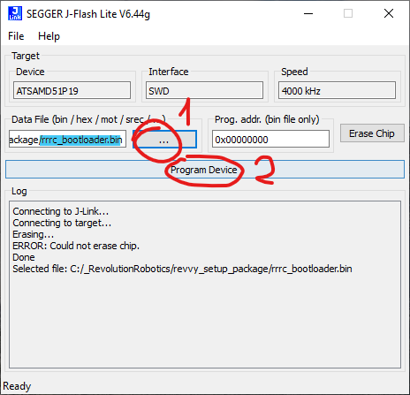
Flash MCU firmware with JFlash Lite II.
1) Browse our firmware
2) Program device
If connection to the target was successful, ERROR messages can be ignored.

Slide 6
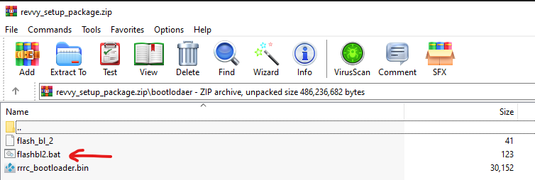
Using JLink command line tool for flashing
1) Install JLink_Windows_V644g.exe
2) Run our flashbl2.bat file (make sure that rrrc_bootloader.bin is next to the flashbl2.bat)

Slide 7
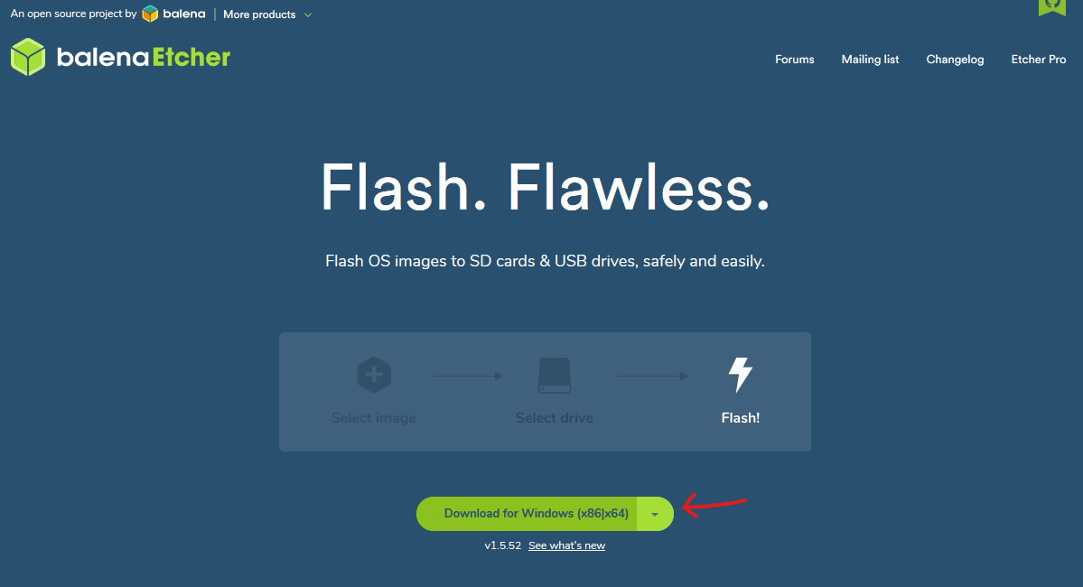
Burn Raspberry PI TF card I.
Download etcher: https://www.balena.io/etcher/
Install etcher

Slide 8
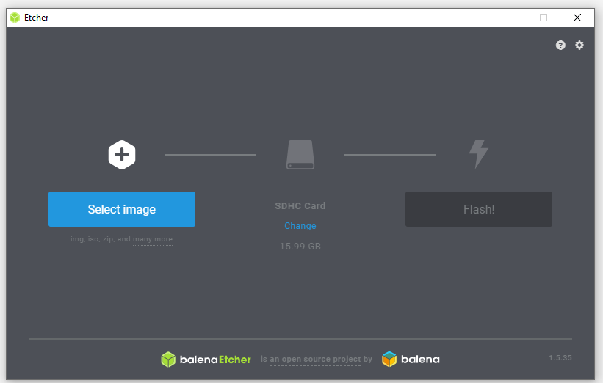
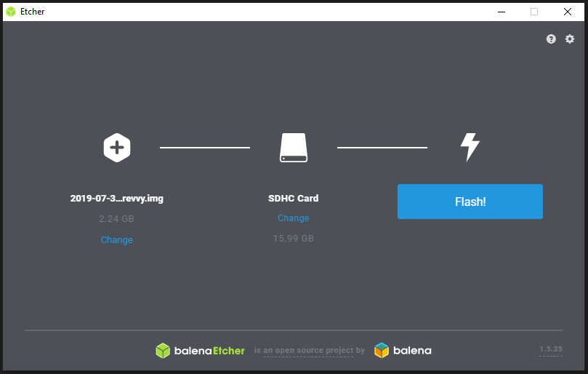
Burn Raspberry PI TF card II.
Select our image:
Select target TF card:
Press Flash!

